Slide 1
Chap4 Tensorflow(II)

Slide 2

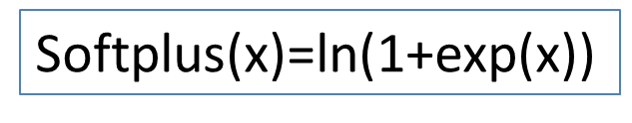
函數向量(I)
import tensorflow as tf
tf.nn.relu
tf.nn.elu
tf.nn.softplus
tf.nn.sigmoid
tf.tanh

Slide 3
均方平方差（Mean Squared Error）
平方差很好理解，預測值與真實值直接相減，為了避免得到負數取絕對值或者平方，再做平均就是均方平方差
注意這裡預測值需要經過sigmoid激活函數，得到取值範圍在0到1之間的預測值
平方差可以表達預測值與真實值的差異，但在分類問題種效果並不如交叉熵好

Slide 4
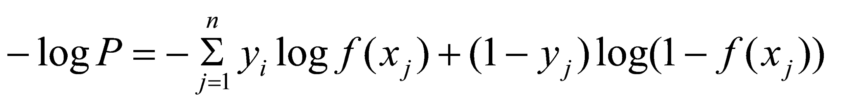
Cos/Loss function(I)
(1) Binary Cross Entropy:
交叉熵得到的值一定是正數，其次是預測結果越準確值越小，注意這裡用於計算的「f(xj)」也是經過sigmoid激活的，取值範圍在0到1。
如果label是1，預測值也是1的話，就是1 * ln(1)等於0，後一項(1 - y) * ln(1 – f(xj))也就是0 * ln(0)等於0，Loss函數為0，反之Loss函數為無限大非常符合我們對Loss函數的定義。

Slide 5
Cos/Loss function(I)
(1) Binary Cross Entropy:
cost = tf.reduce_mean(( (y*- tf.log(pred)) +((1 - y) * tf.log(1.0 - pred)) ) * -1)
learning_rate = 0.01
train_step = tf.train.GradientDescentOptimizer(learning_rate).minimize(cost)
TensorFlow 1.x

Slide 6
TensorFlow的交叉熵函數(I)
tf.nn.sigmoid_cross_entropy_with_logits
(labels=None, logits=None)
Let x = logits , y= labels (known).
The logistic loss is
y* -log(sigmoid(x)) + (1 - y) * -log(1 - sigmoid(x))
cost=tf.reduce_mean((tf.nn.sigmoid_cross_entropy_with_logits(labels=Y,logits=x))

Slide 7
Ex1 :(a) Binary Cross Entropy
Binary Cross Entropy
Y=[1,0.01,0.01]
fx=[0.99,0.02,0.01]
Find cost function using Binary Cross Entropy=?

Slide 8
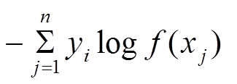
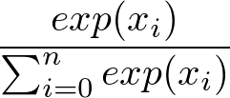
Cos/Loss function(II)
(2) Cross Entropy
softmax=
cost = tf.reduce_mean(tf.nn.softmax_cross_entropy_with_logits(logits=out,labels=Y))

Slide 9
Multiple Classes
就在於前邊的softmax函數具有“排它”性質，某一個輸出增大，必然導致其它​​類別的輸出減小，因為其進行了歸一化操作，使得每個類別的預測輸出概率加和必須為1。
Softmax 函數通常會放在類神經網路的最後一層，將最後一層所有節點的輸出都通過指數函數 (exponential function)，並將結果相加作為分母，個別的輸出作為分子。

Slide 10
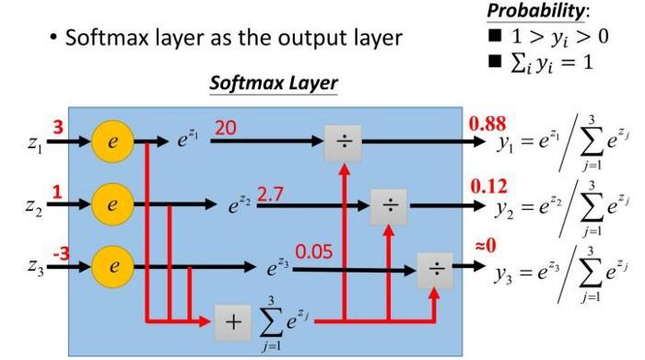

Slide 11
tf.nn.softmax_cross_entropy_with_logits(logits=out,labels=Y)
logits = [[4.0, 2.0, 1.0], [0.0, 5.0, 1.0]]
labels = [[1.0, 0.0, 0.0], [0.0, 0.8, 0.2]]
tf.nn.softmax_cross_entropy_with_logits(labels=labels, logits=logits)
Ex1 :(b) Find Cross Entropy =?
logits = [[4.0, 2.0, 1.0], [0.0, 5.0, 1.0]]
labels = [[1.0, 0.0, 0.0], [0.0, 0.8, 0.2]]

Slide 12
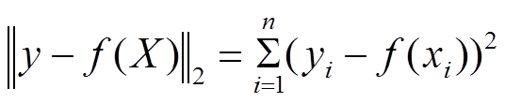
Cos/Loss function(III)MSE
Mean Squared Error(MSE): Regression
find min
fpred = tf.matmul(X,w)+b
error = fpred - Y
cost = tf.reduce_mean(tf.square(error))

Slide 13
Regression問題時，Normal Distribution使用Linear當Activation Function
Binary Classification問題時，Bernoulli Distribution使用Sigmoid當Activation Function
Multi-class Classification問題時，Categorical Distribution使用Softmax當Activation Function

Slide 14
Compare MSE and Cross Entropy
computed =f(x) | targets =Y | correct?
-----------------------------------------------
(1) 0.3 0.3 0.4 | 0 0 1 | yes
(2) 0.3 0.4 0.3 | 0 1 0 | yes
(3) 0.1 0.2 0.7 | 1 0 0 | no
MSE=((0.3)^2+0.3^2+0.6^2)/3.0=0.54
Cross =-(0*ln(0.3)+0*ln(0.3)+1*ln(0.4))=-ln(0.4)

Slide 15
Ex1 :(a) Binary Cross Entropy
Binary Cross Entropy
Y=[1,0.01,0.01]
fx=[0.99,0.02,0.01]
Find cost function using Binary Cross Entropy=?
Ex1 :(b) Find Cross Entropy =?
logits = [[4.0, 2.0, 1.0], [0.0, 5.0, 1.0]]
labels = [[1.0, 0.0, 0.0], [0.0, 0.8, 0.2]]

Slide 16
Ex 2:XOR Problem: Two Layer
(a) Using Binary Cross Entropy
(b) Using Mean Squared Error:(MSE)
(1) using f1(z)=sigmoid(z)
(2) using f1(z)=reLu(z)
f2(z)=sigmoid(z)

Slide 17
Ex3 :MNIST: Two Layer
This MNIST dataset is a set of 28×28 pixel grayscale images which represent hand-written digits.
Step 1 :We load the data by running :
from tensorflow.examples.tutorials.mnist import input_data
mnist = input_data.read_data_sets("MNIST_data/", one_hot=True)

Slide 18
Setup Training Data
Step 2 : Training Data
train_X, train_Y,test_X, test_Y = mnist.train.images, mnist.train.labels, mnist.test.images, mnist.test.labels

Slide 19
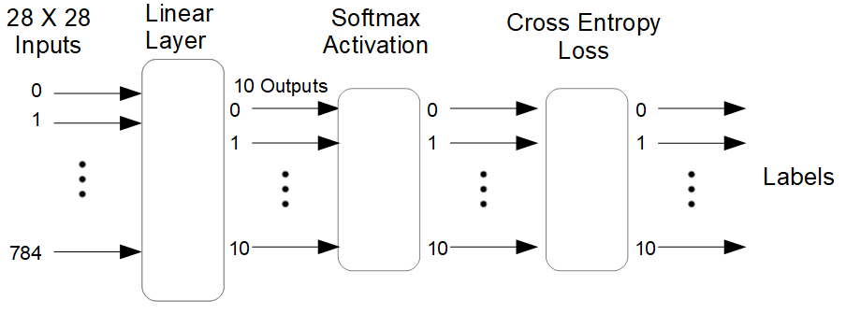
Step 3 Two Layers+ Cross Entropy
Functions : (1)ReLU+ (2)Softmax
Input Data
X=784
Y=10
nodes=300

Slide 20
Results
epochs=10
learning rate =0.01
print (“cost value”,cost)

